Slide 1
fABs and ragmentation
WHERE IS The added valuE?

Slide 2
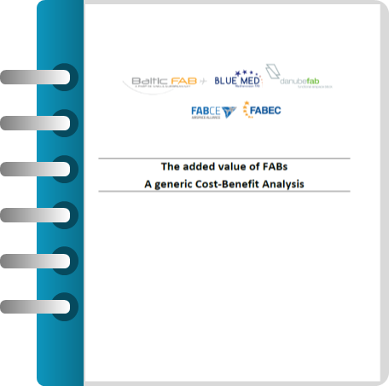
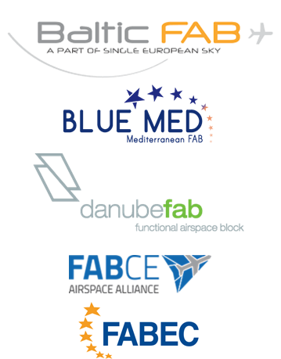
Introduction
Int
Inter-fab
Inter-FAB Coordination Platform
Study on the added value of FABs
How can FABs contribute
to reduce ATM fragmentation?

Slide 3
Focus on fragmentation
Airspace fragmentation
Operational fragmentation
ATS delegations reviewed and extended based on the operational needs
Some barriers still exist (sovereignty, liability, financial mechanisms)
Interoperability issues have prevented from wider implementation of more extensive cross-border airspace structures
All FABs have operational working structures focusing on operational issues and many successful projects that bring clear value to users
Technical fragmentation
Organisational fragmentation
Main barriers for introducing more extensive cross-border ATM operations (different ATM systems in the neighbouring countries, often in different phases of lifecycle, made implementation of common functions challenging)
Limited examples of consolidation of the ACC centres in Europe
Usually, FABs have a kind of centralized secretariat either on State or on ANSP side or having a combined one

Slide 4
THE ADDED VALUE OF FABS
Operations
(State 3, ANSP 28)
Finance & Performance
(State 5, ANSP 9)
77
Safety
(State 4, ANSP 5)
Human Resources
(ANSP 3)
Technology
(ANSP 20)
77 activities captured
May 14/15, 2019 – Research Workshop ‘Fragmentation in Air Traffic and its Impact on ATM Performance’, Budapest

Slide 5
THE ADDED VALUE OF FABS
14 activities increase the safety level
16 activities support the environmental target
77
15
06
14
16
amongst the 77 activities captured
15 activities increase capacity
06 activities increase efficiency
May 14/15, 2019 – Research Workshop ‘Fragmentation in Air Traffic and its Impact on ATM Performance’, Budapest

Slide 6
Fab initiatives
Among FAB initiatives aiming at increasing safety level it is worth to mention
BLUE MED FAB
FABEC and Danube FAB
Safety Experts are performing jointly occurrences investigations, analysis and follow-up at FAB Level using a virtual BLUE MED FAB Area of Responsibility (AoR) defined in the eTOKAI reporting tool, to share the “cross border” occurrence reported
ANSPs share staff to conduct audits at the partner organizations
In FABEC an international audit cooperation team (IntACT) is established, composed of ANSPs representatives that is auditing all areas of air navigation services: the operational units, the technical branches, all supporting processes and the safety management system itself
In DANUBE FAB common audit activities are run between Bulgarian and Romanian CAAs
FABCE
ANSPs are working on coordinated contingency procedures and technical solutions in order ensure in emergency cases a significant increase of contingency capacity

Slide 7
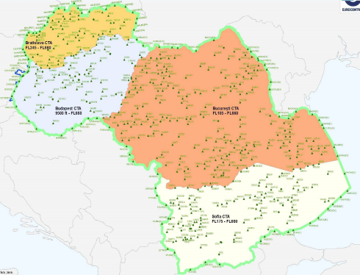
Fab initiatives
Among FAB initiatives aiming at increasing capacity, supporting environmental targets and increasing efficiency, it is worth to mention
- 700,000 NM/per year
- 6,437,000 NM/in 2018
- 1,100,000 NM/per year
SECSI FRA
South East Common Sky Initiative Free Route Airspace
SEEN FRA
South East Europe Night Free Route Airspace
BLUE MED FRA

Slide 8
example
Both the States and the ANSPs dimensions are taken into account for each domain (OPS, Tech, Safety etc.)
May 14/15, 2019 – Research Workshop ‘Fragmentation in Air Traffic and its Impact on ATM Performance’, Budapest

Slide 9
Example in detail
Short description of activity
Qualitative Impact Assessment made by Experts
Examples from the FABs having this activity
May 14/15, 2019 – Research Workshop ‘Fragmentation in Air Traffic and its Impact on ATM Performance’, Budapest

Slide 10
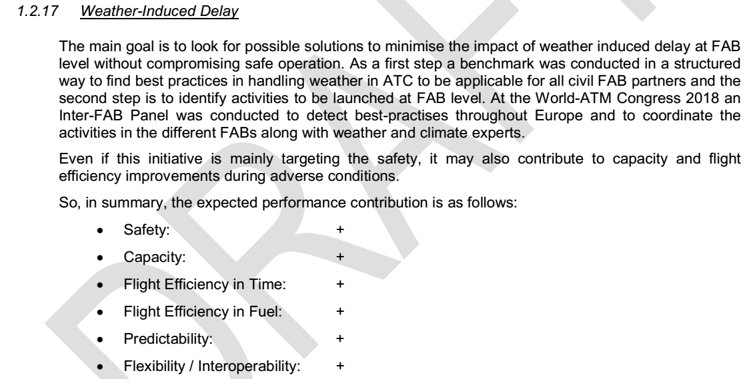
Intangible benefits
For a Cost-Benefit-Analysis quantitative results are obligatory. In case only qualitative results are available neither benefits nor costs of the activity are considered
Assumption:
→ Note: for activities with a qualitative assessment only it is assumed that the benefits will at least cover the costs
May 14/15, 2019 – Research Workshop ‘Fragmentation in Air Traffic and its Impact on ATM Performance’, Budapest

Slide 11
Tangible benefits
Quantitative Benefits and Costs are only taken into account if they have been conducted by a third party (SESAR, NM…). Advantages are: coherence of methodology, available data and neutrality
Example:
Cross-Centre Arrival Management with a net present value of approx. 240 Mio EUR calculated by SESAR
May 14/15, 2019 – Research Workshop ‘Fragmentation in Air Traffic and its Impact on ATM Performance’, Budapest

Slide 12
Cost-Benefit-Analysis
Quantitative Benefits Costs
X AMAN with approx. 25 Mio EUR p.a.
Free Route with approx. 125 Mio EUR p.a.
Added Value of the 9 FABS:
Approx. EUR 145 Mio p.a.
Other Costs ≈ Approx EUR 2.000.000 p.a.
Total Costs: approx. 5 Mio EUR p.a.
Approx. 670 Missions ≈ EUR 340.000 p.a.
Internal/External Resources approx. 17 FTE ≈ EUR 2,7 Mio p.a.
May 14/15, 2019 – Research Workshop ‘Fragmentation in Air Traffic and its Impact on ATM Performance’, Budapest

Slide 13
Cost-Benefit-Analysis
Activity | Total Nominal Cost 2014-2029 in Euro | Quantified Benefit 2014-2029 in Euro | NPV 2014-2029 discounted to base year 2014 | Source
Free Route Airspace (FRA) | 25 million euro | 2.000 million euro | 1.364,8 million euro | Network Manager
Extended Arrival Management (X MAN) |  |  | 238.253.979 | SESAR
Joint International Representation |  | 1.200.000 | 889.471 | FAB CE
TOTAL |  |  | 1.604 million euro
The net present value of the nine FABs is 1.6 Billion EUR
May 14/15, 2019 – Research Workshop ‘Fragmentation in Air Traffic and its Impact on ATM Performance’, Budapest

Slide 14
summary
Costs
Each FABs needs as an average slightly less than 2 FTE to administer and coordinate the FAB activities
The FAB activities induce as an average 75 missions per FAB and year
Each FAB needs some 200.000 EUR in other costs as an average to execute its activities
Benefits
FABs are conducting some 77 activities / projects leading to positive qualitative results and in some cases to quantitative results
The net present value of the quantified activities / projects are 1,6 Billion Euro or an added value of 145 Mio EUR p.a.
→ The distinction between a “FAB activity„ and a “Non-FAB activity is seamless„.
At least, the FAB is a facilitator and accelerator
May 14/15, 2019 – Research Workshop ‘Fragmentation in Air Traffic and its Impact on ATM Performance’, Budapest

Slide 15
COnclusioN
FABs have important qualitative impact to ECAC airspace defragmentation
77 projects identified which are contributing to increased safety level, capacity, environmental targets and efficiency from regional perspective
Even though those projects are assessed from qualitative aspect, it is expected that the benefits will at least cover the costs
Main qualitative benefit is achieved from cross-border cooperation of stakeholders, triggered by FAB establishment – initiation and facilitation
Additional benefits are achieved at InterFAB level = defragmentation at bigger scale
Bigger projects can be assessed from quantitative perspective
Significant and measurable benefits at airspace user side
May 14/15, 2019 – Research Workshop ‘Fragmentation in Air Traffic and its Impact on ATM Performance’, Budapest

